Slide 1
Banking Helpdesk
Team FLEX

Slide 2
Mission Statement
We strive to uphold a high level of satisfaction as well as maintaining a strong relationship with other employees through exceeding expectations.
Our team is the first, and only point of contact for any IT related issues within the organisation, and therefore we create a welcoming and supportive environment.
We seek to achieve this through carrying out a number of activities:

Slide 3
Stakeholder Analysis
There are numerous stakeholders that are involved with our help desk.
These include the -
Employees
Technical Staff
Suppliers
General Public

Slide 4
Prioritised Requirements:
 | Must Have | Should Have | Could Have | Won’t Have
Employees: | A notification system to enable users to know when their problem has been logged. | A straightforward way of declaring you have a problem - telephone call. | A system which provides the employee with an estimated waiting time. | Won’t log problems based on the employee's level of status, therefore managers and directors may become frustrated due to waiting.
 | Must Have | Should Have | Could Have | Won’t Have
Technical Staff: | A sufficient budget for the team to work with, in order to maintain and update the bank's technology - in regards to both software and hardware. | The scope to communicate and select their own suppliers, as they are the people with technical knowledge to provide a more efficient help desk system. | Employees within the bank which are not demanding, and understand the technician’s workload. | Won’t include requirements which haven’t been agreed by all stakeholders.

Slide 5
Use Cases:
A use case is a series of actions that describes the interaction between an actor and a system. It helps to identify and clarify requirements within a system.

Slide 6
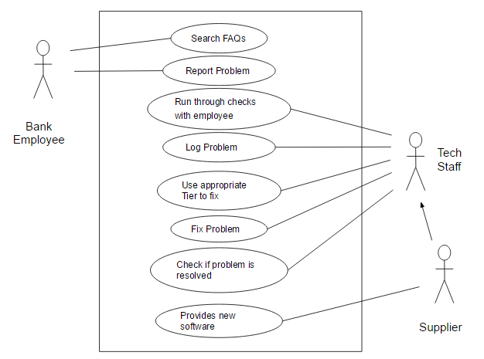
Use Case Diagram:

Slide 7
Written Use Case
Name of case: Fix Problem
Goal: For the help desk to fix the IT problem given by the employees of the bank, efficiently and effectively.
Actors: Primary and secondary
Success path
Failure path

Slide 8
Development Approach - Crystal Methodology
We decided to develop our system while following Crystal methodology, this is because
Crystal Methodology incorporates frequent delivery
Uses Osmotic communication
Reflective Development
Has an emphasis on Personal Safety

Slide 9
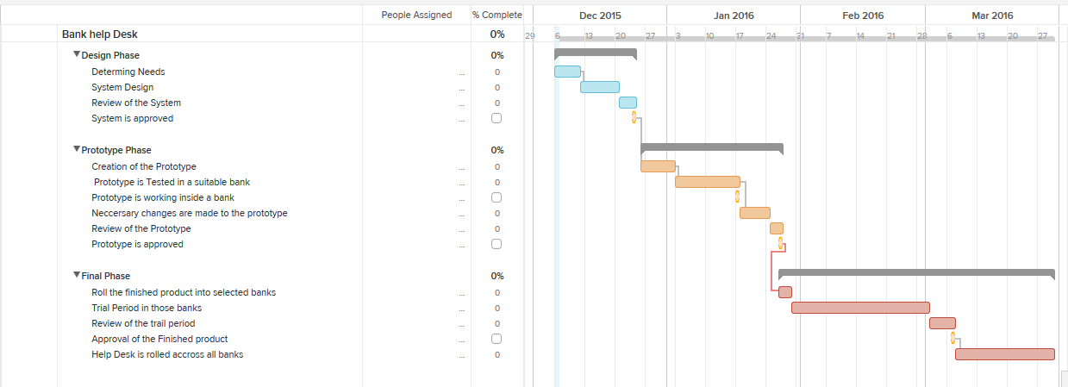
Development Gantt Chart

Slide 10
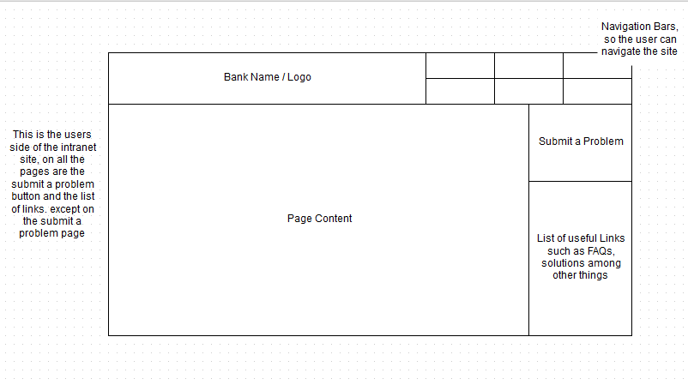
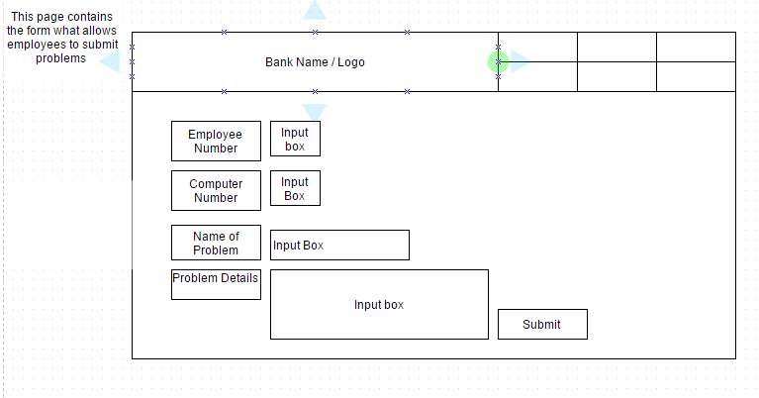
Lo-Fi Diagrams

Slide 11
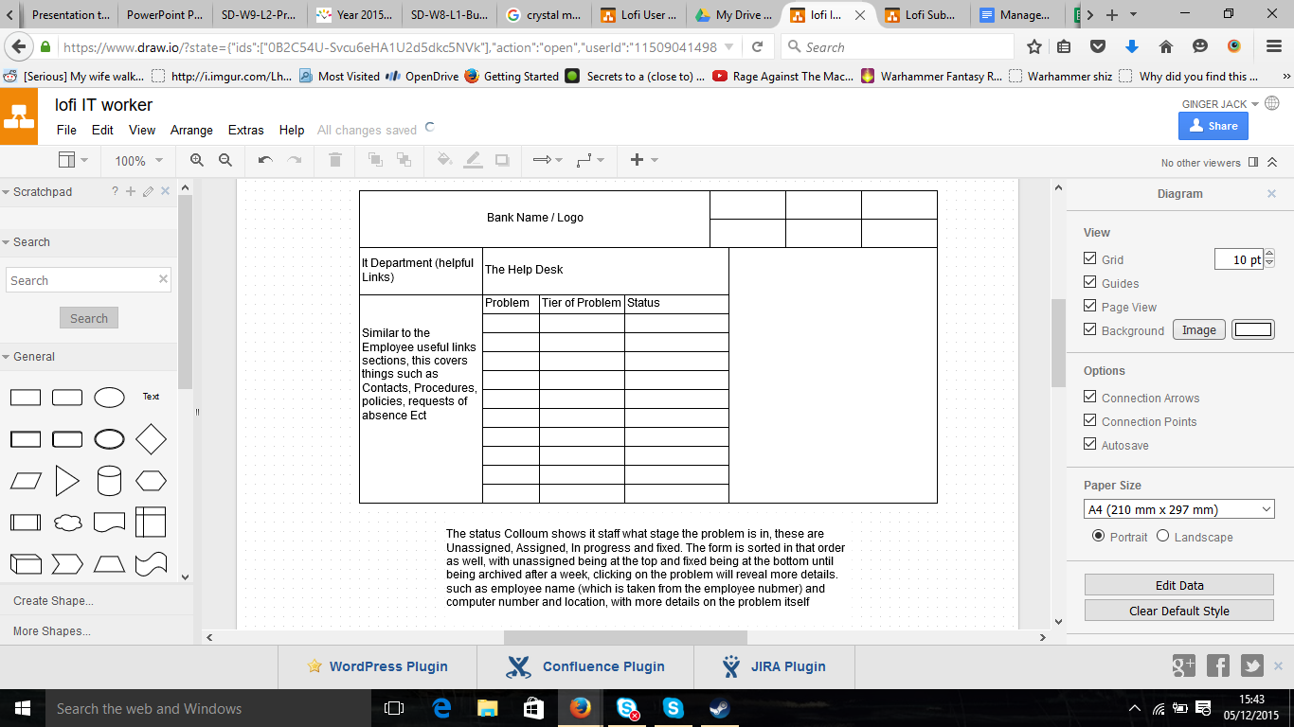
Lo Fi Continued

Slide 12
Critical success factors
Staff ( Specialists, Telephonists, Technicians )
Database
Logging portal ( Email, Fax, Phone, Website )
Staff tools ( Computers, Software, Hardware, Printers, Scanners )
The process

Slide 13
Summary
We are developing a helpdesk system for a bank, our stakeholders include:
Employees, technical staff, suppliers , general public
We used crystal methodology in order to create it.
Critical success factors include:
Staff, database, logging portals, staff tools and the process.

